Slide 1
Fundamentals of Electric Aircraft/eVTOL Design
Tony Tao
2022.09.13
16.82x

Slide 2
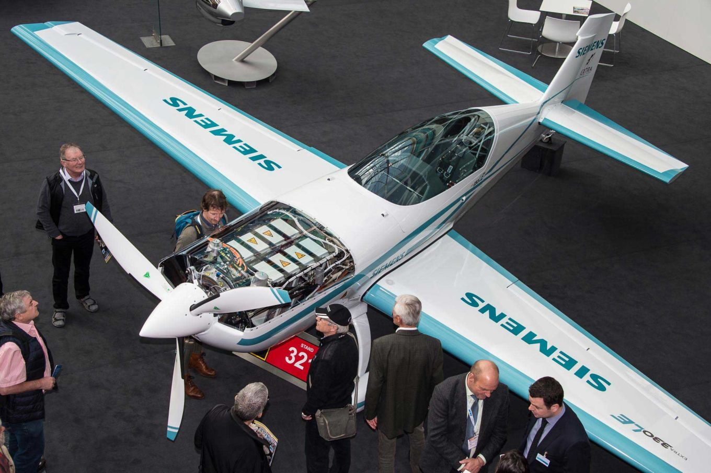
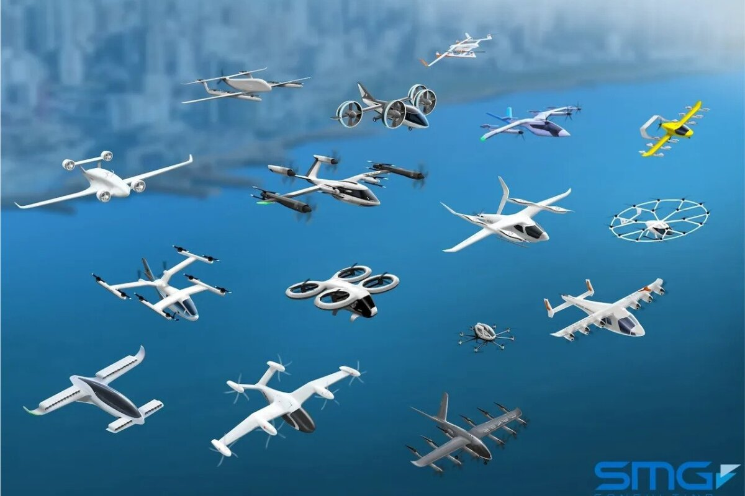
Electric Flight
Question 1:
How do we design electric aircraft?
Question 2:
Why do eVTOLs look so weird?
What drives these designs?
Lecture Sections:
Powertrains
Electric Range
eVTOL Configuration

Slide 3
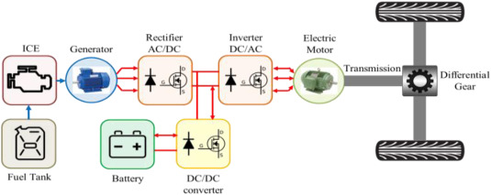
1. Powertrain Elements

Slide 4
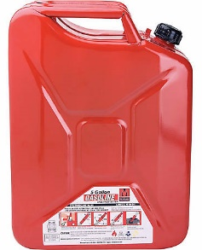
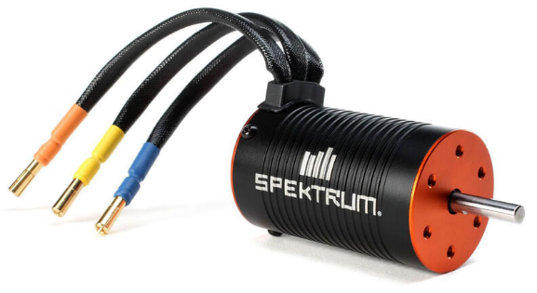
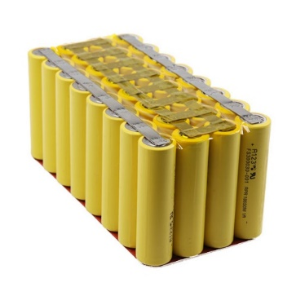
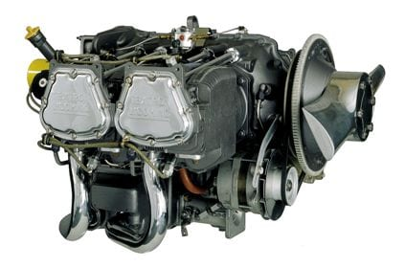
(Fuel & engines) vs (Batteries & motors)
ICVs tolerate engines to use fuel.
EVs tolerate batteries to use motors.
Performance
Power
Energy
Energy
Power
Complexity & Cost

Slide 5
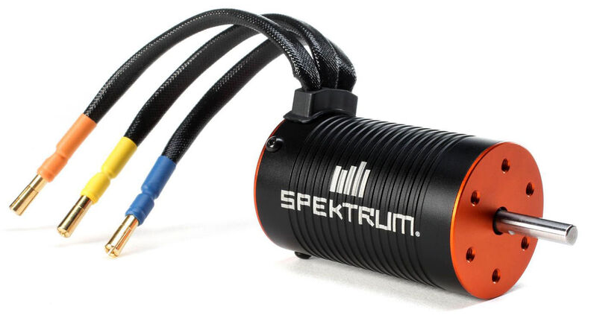
How do batteries work?
Cathode
terminal (+)
Load (ESCs, motors, etc)
e⁻
Li⁺
Load (ESCs, motors, etc)
Separator
Cathode
Anode
Anode
terminal (-)
e⁻
Goo (organic solvent electrolyte)
“Current” (amps)

Slide 6
What’s actually depleting in a battery?
Full battery
Empty battery
Load (ESCs, motors, etc)
Load (ESCs, motors, etc)
e⁻
e⁻
Li⁺
Li⁺
Separator
Separator
Cathode
Anode
Cathode
Anode

Slide 7
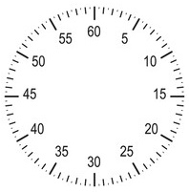
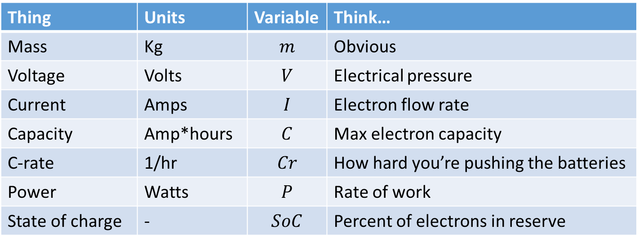
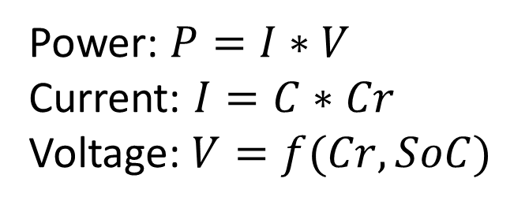
Voltage, Current, C-rate, Power
Thing | Units | Variable | Think…
Mass | Kg | $$m$$ | Obvious
Voltage | Volts | $$V$$ | Electrical pressure
Current | Amps | $$I$$ | Electron flow rate
Capacity | Amp*hours | $$C$$ | Max electron capacity
C-rate | 1/hr | $$Cr$$ | How hard you’re pushing the batteries
Power | Watts | $$P$$ | Rate of work
State of charge | - | $$SoC$$ | Percent of electrons in reserve
2C
0% SoC
100% SoC
6C
0% SoC
Power: $P=I∗V$
Current: $I=C∗Cr$
Voltage: $V=f(Cr,SoC)$
100% SoC

Slide 8
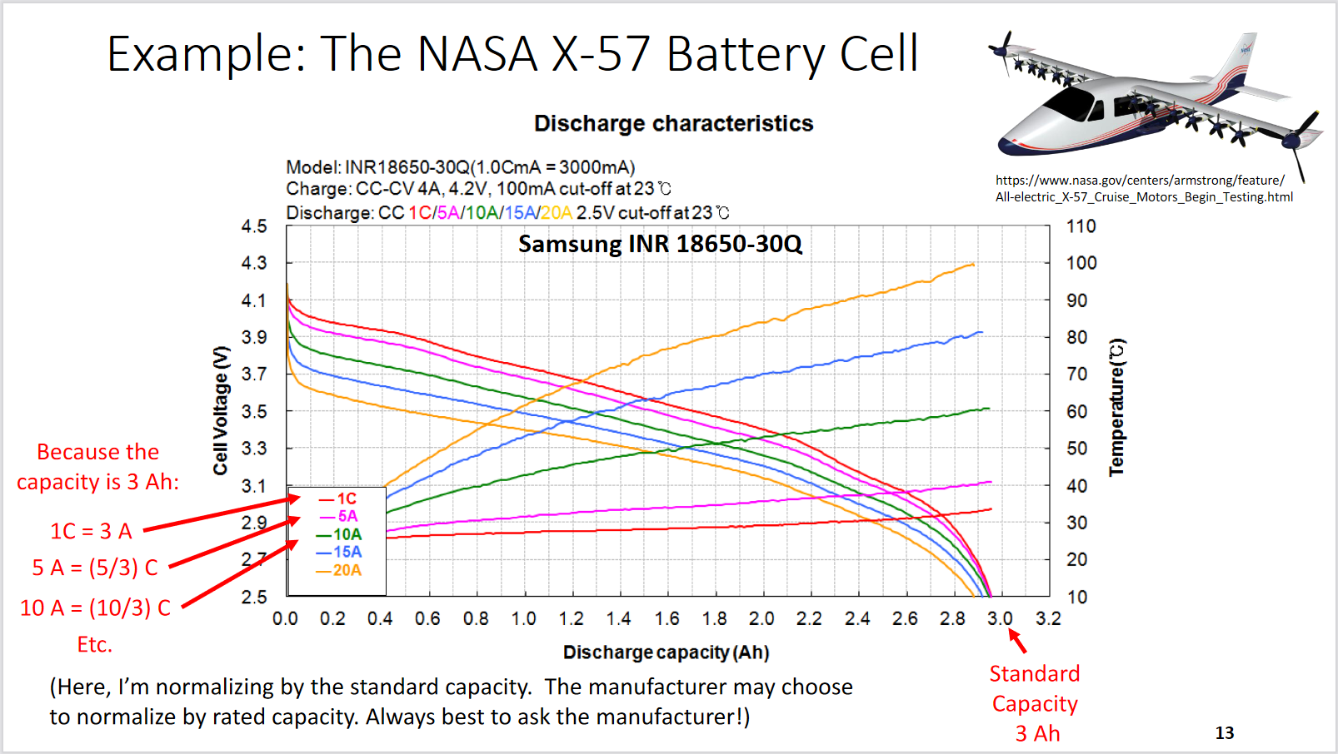
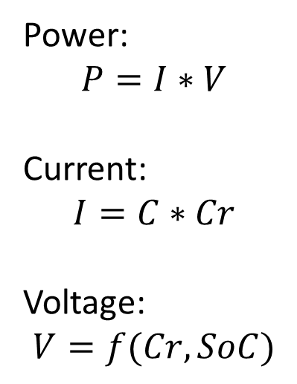
Battery Weakening with C rate
Power:
$$P=I∗V$$
Current:
$$I=C∗Cr$$
Voltage:
$$V=f(Cr,SoC)$$
Emptying in 3 mins
Emptying in 60 mins
Emptying in 3 mins
Emptying in 60 mins
Brian J. German, “Introduction to Batteries and Cell Discharge Modeling for Electric Aircraft Design” AIAA Aviation, Atlanta, Georgia, June 2018

Slide 9
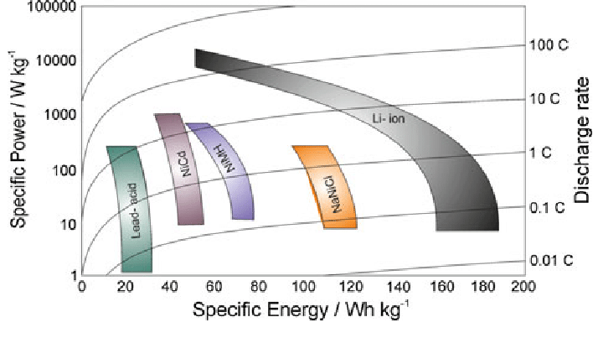
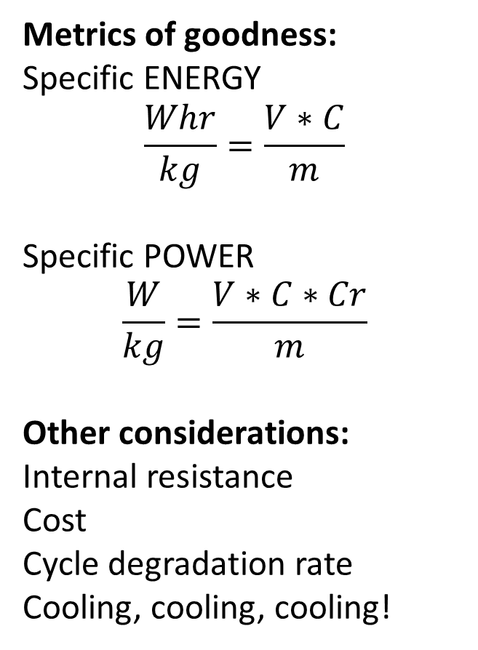
Battery Goodness
Metrics of goodness:
Specific ENERGY
$$\frac{Whr}{kg}=\frac{V∗C}{m}$$
Specific POWER
$$\frac{W}{kg}=\frac{V∗C∗Cr}{m}$$
Other considerations:
Internal resistance
Cost
Cycle degradation rate
Cooling, cooling, cooling!
Goodness
Trade off
Hover or Acceleration
Cruise range
Whoever is in charge of the batteries, watch this video:
https://www.youtube.com/watch?v=QlDd3jkcxoQ

Slide 10
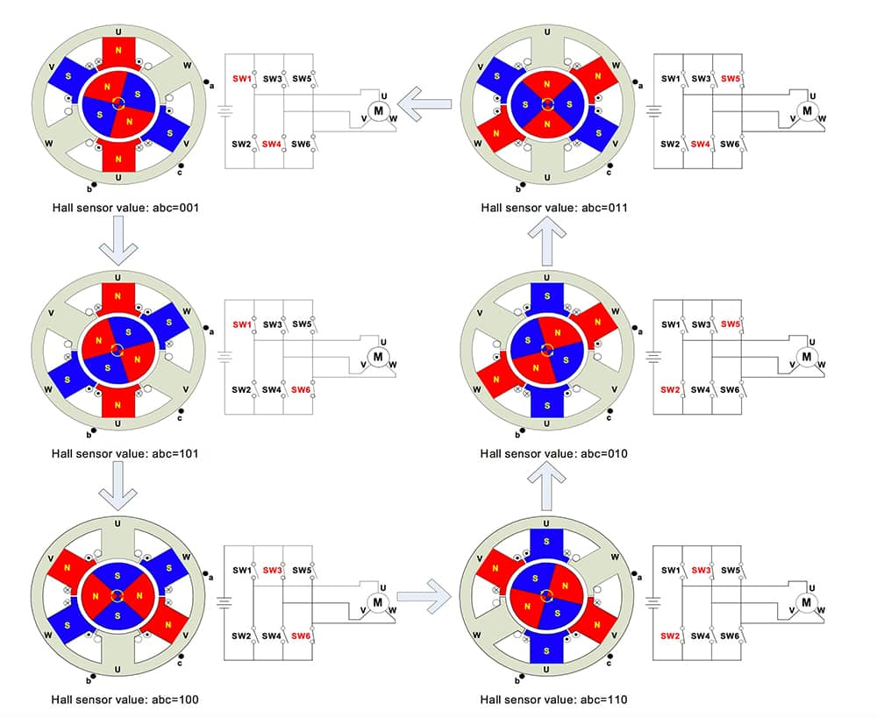
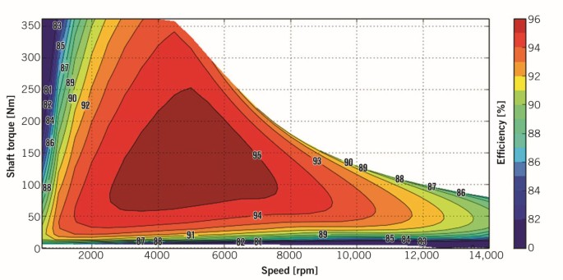
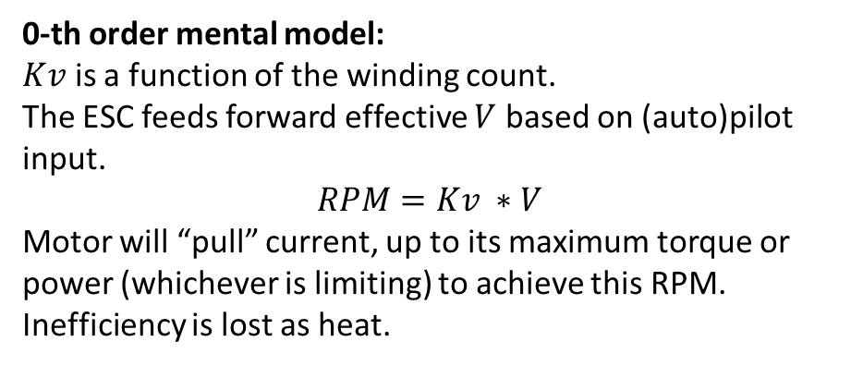
Electric Motors
Example commutation
Start thinking of motors in terms of RPM, Torque
Example efficiency map
0-th order mental model:
$Kv$ is a function of the winding count.
The ESC feeds forward effective $V$ based on (auto)pilot input.
$$RPM=Kv ∗V$$
Motor will “pull” current, up to its maximum torque or power (whichever is limiting) to achieve this RPM. Inefficiency is lost as heat.

Slide 11
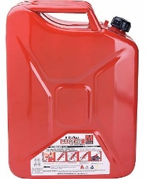
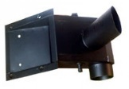
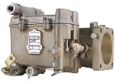
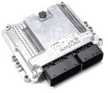
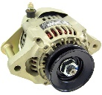
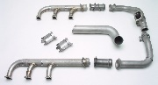
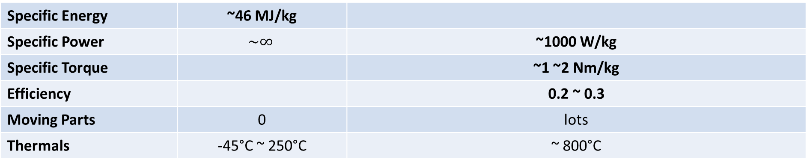
Internal Combustion Drivetrains
Fuel
Engine System
Prop
Support Equipment
Engine Block
Airbox & Air Filter
Carburetor(s)
Engine Control Unit
Alternator
Exhaust/ Muffler
(Typical values)
Specific Energy | ~46 MJ/kg
Specific Power | $$\sim ∞$$ | ~1000 W/kg
Specific Torque |  | ~1 ~2 Nm/kg
Efficiency |  | 0.2 ~ 0.3
Moving Parts | 0 | lots
Thermals | -45°C ~ 250°C | ~ 800°C

Slide 12
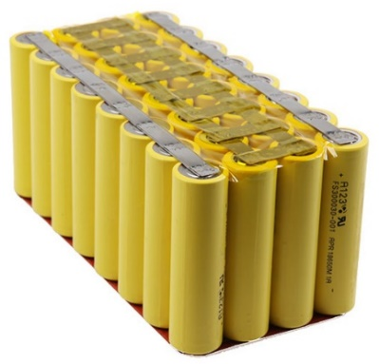
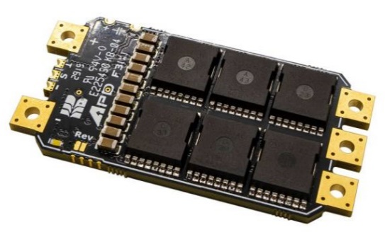
Electric Drivetrains
Batteries
Electronic Speed Controller (“ESC”)
“Motor Driver”
Motor
Prop
(Typical values)
Specific Energy | Cell-level ~180 ~240 Whr/kg
 | Pack-level ~130 ~180 Whr/kg ~0.5-0.7 MJ/kg
Specific Power | Energy-biased: ~500 W/kg Power-biased: ~2000 W/kg | ~20,000 W/kg | ~5000 W/kg (big motors) ~10,000 W/kg (small motors)
Specific Torque |  |  | ~10 Nm/kg
Efficiency | Function of Cr, ~93% over a mission | >~0.95 above 50% throttle | ~0.90 ~0.95
Moving Parts |  |  | 1
Thermals | 10°C - 60°C (longevity) …. 100°C (combustion) | ~80°C | ~100°C

Slide 13
2. Electric Aircraft Range

Slide 14
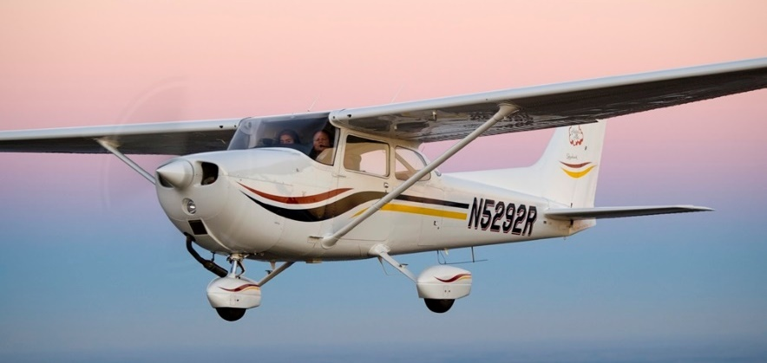
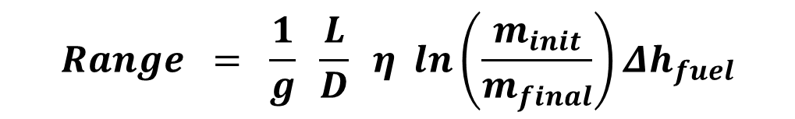
Breguet Range Equation
$$Range = \frac{1}{g} \frac{L}{D} η ln\left(\frac{m_{init}}{m_{final}}\right)Δh_{fuel}$$
Gravity
Energy density of fuel
Aerodynamics
Total fuel burned
Propulsive Efficiency
$$R_{typicalFixedWing }=\frac{1}{9.81\frac{m}{s^{2}}} ∗12 ∗0.15∗ln\left(\frac{2400}{2400−300}\right)∗46,000,000\frac{J}{kg}≈1120 km≈700 mi$$
Cessna 172
Range: 696 mi

Slide 15
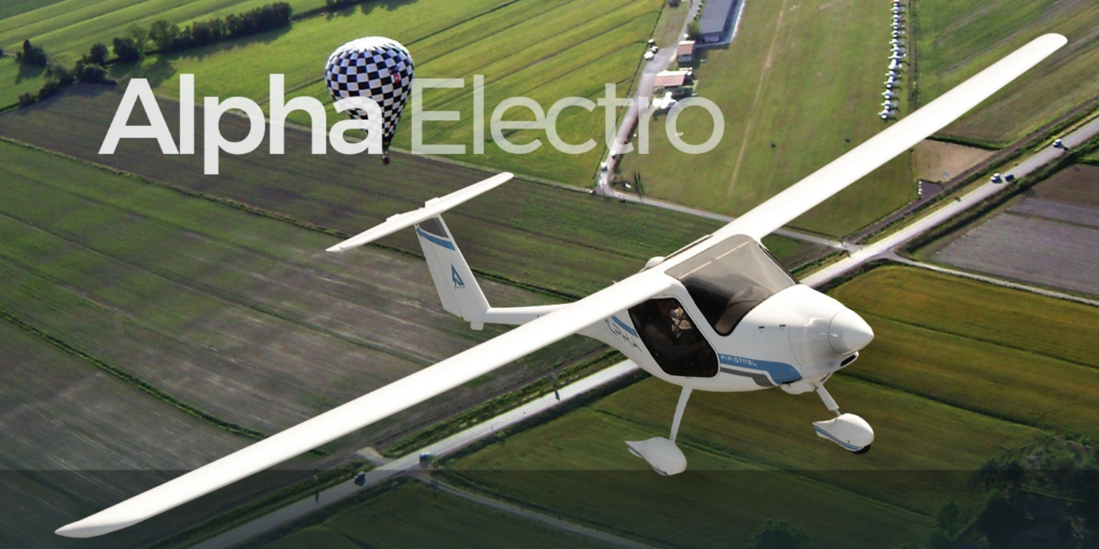
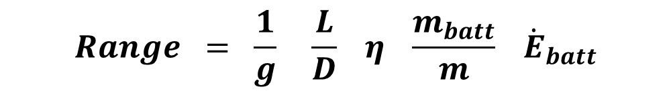
Electric Range Equation
$$Range = \frac{1}{g} \frac{L}{D} η \frac{m_{batt}}{m} {\dot{E}}_{batt}$$
Gravity
Battery chemistry
Aerodynamics
Battery mass ratio
Propulsive Efficiency
$$R_{typicalFixedWing }=\frac{1}{9.81\frac{m}{s^{2}}} ∗12 ∗0.75∗0.3∗150\frac{Whr}{kg}≈150 km≈90 miles$$
Multi-rotors: ~1
Fancy helicopters: ~3-6?
Winged vehicles: 10+
(This is why we need wings.)
Pipistrel Alpha Electro
86 miles advertised

Slide 16
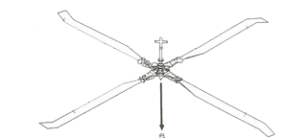
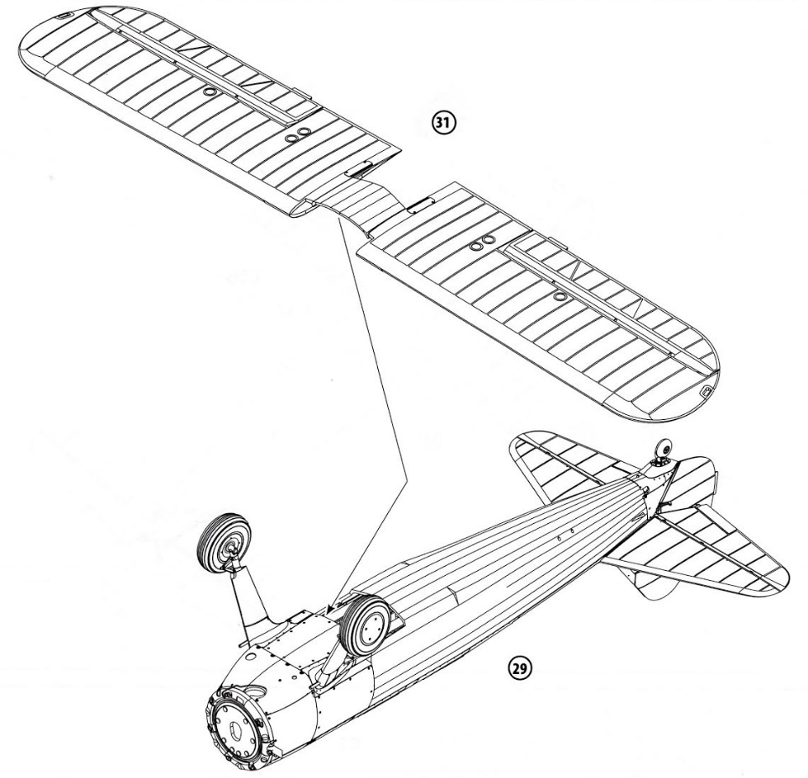

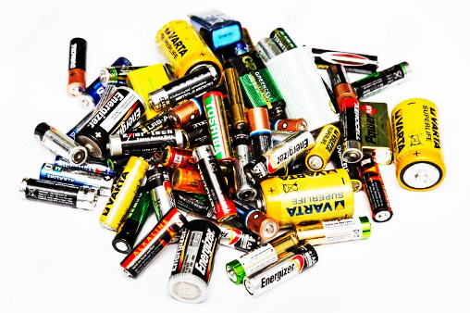
2. eVTOL Configuration

Slide 17

Futurama said it best

Slide 18
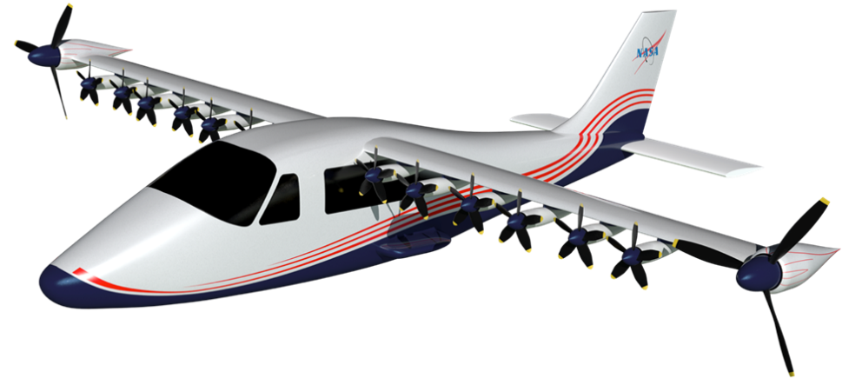
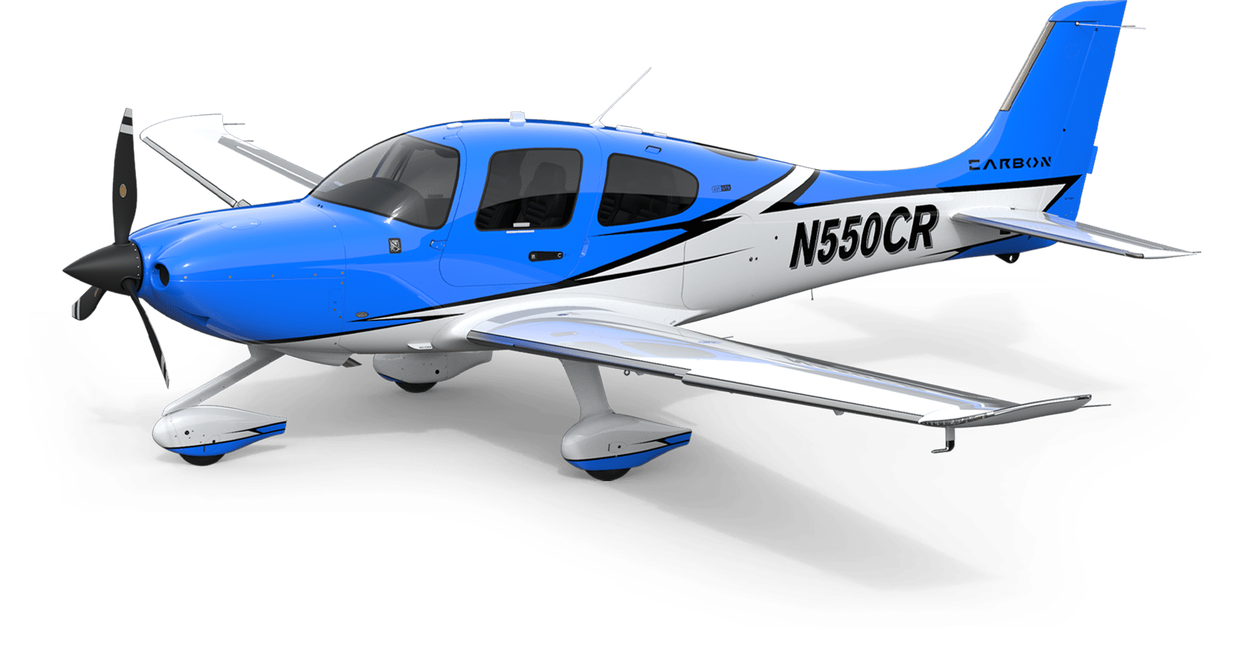
Configuration Flexibility Provided by Electric Drivetrains
Cost per propulsion unit | $$$$ | $
Single propulsion unit loss | ☹ | 😐
Airflow shaping | O | ooOOOooOOooo
Controllability | Few, slow | Many, nearly instant

Slide 19
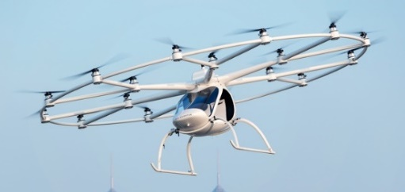
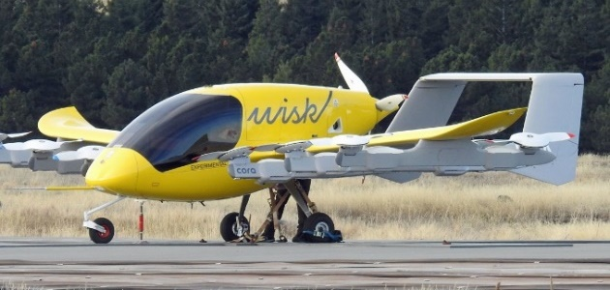
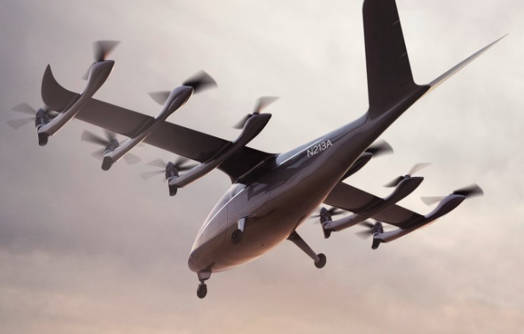
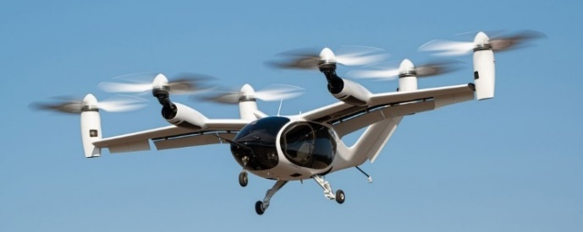
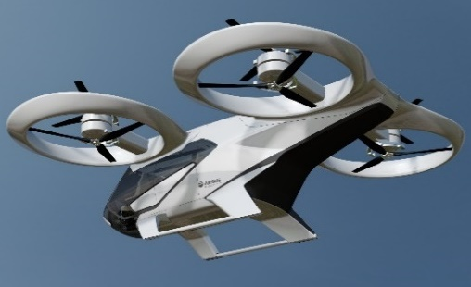
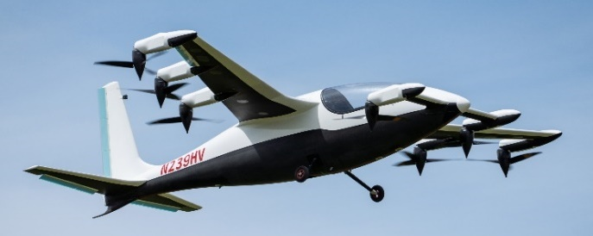
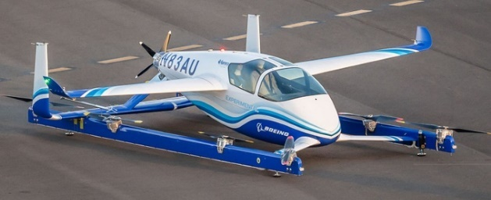
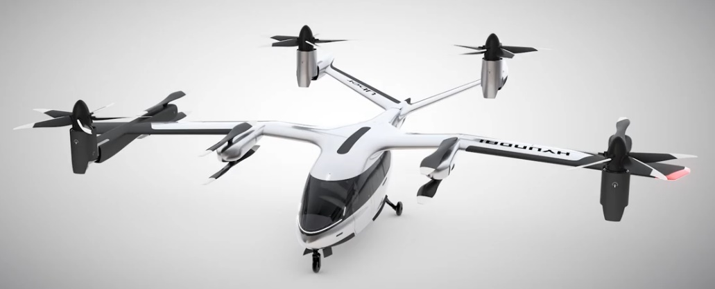
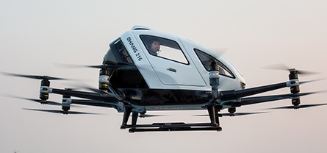
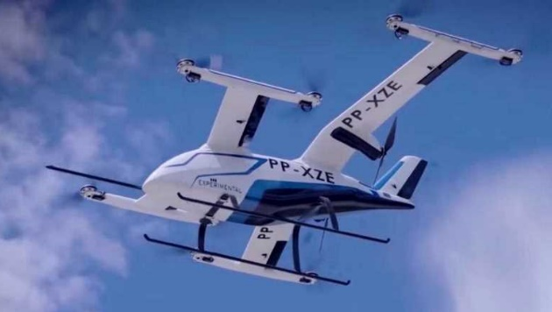
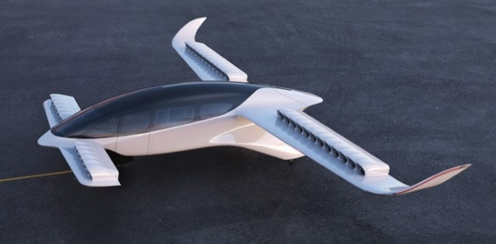
The eVTOL Design Space
Winged
Hover only
Propulsion Tilt
0%, cruise on wing
(typically 33% to 50%)
100%
“Big multicopter”
“Separate Lift Cruise” (SLC)
“Tilt something”
“Tilt everything”
Volocopter
Wisk
Archer
Joby S4
CityAirbus
Heaviside
Hyundai
Boeing PAV
eHang
Embraer Eve
Lilium Jet

Slide 20


Typical VTOL Mission Power Profile
Cruise
Outbound Transition (OT)
Inbound Transition (IT)
Hover Takeoff
(HTO)
Hover-land
(HL)
Hover and outbound transition are usually driving from configuration standpoint
Cruise: Electric range equation, as previously discussed
Inbound transition and Hover-land are usually configurationally easy if HTO, OT are met, but must be accomplished with reduced max power

Slide 21
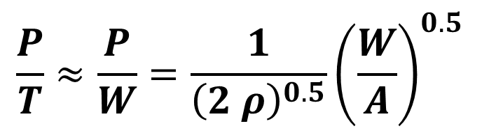
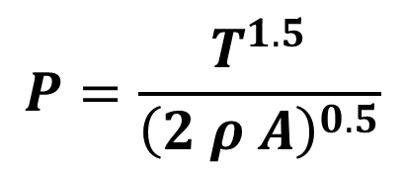
Hovering Power
“Ideal Hover Power”:
(Power delivered uniformly into air molecules)
$$P=\frac{T^{1.5}}{{\left(2 ρ A\right)}^{0.5}}$$
$$\frac{P}{T}≈\frac{P}{W}=\frac{1}{{\left(2 ρ\right)}^{0.5}}{\left(\frac{W}{A}\right)}^{0.5}$$
w
w
w
Power: 100%
~90%
~70%
Assuming you get to choose the best-possible propeller in each situation, you want to minimize disk loading (Thrust over Area).

Slide 22
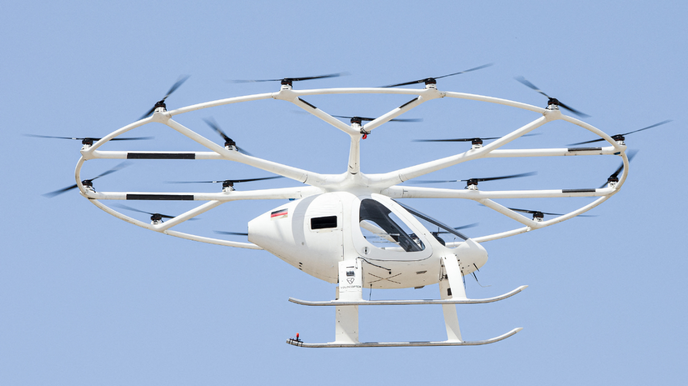


Big Multicopters
$$≈$$
Volocopter
chAIR
https://youtu.be/GKBNTP6D1ag?t=563
Minimize disk loading + Maximize battery fraction = Works fine
No transition required; just hover around
Top speed 30~50 mph
Short range (10-20 miles?)
Limiting factor for forward flight: trade hover efficiency for forward speed, rotor vibe

Slide 23






A word on RPM Thrust Control
Thrust: $T=\frac{1}{2} π ρ ω^{2} r^{4} C_{T}$
Torque: $Q_{aero}=\frac{1}{2} π ρ ω^{2} r^{5} C_{Q}$
Power: $P_{shaft}=\frac{1}{2} π ρ ω^{3} r^{5} C_{Q}$
$Q_{motor}=Q_{aero}+Q_{accel}=Q_{aero}+I_{θθ }\frac{∂ω}{∂t}$
Thrust slew rate (N/s)
$$\frac{∂T}{∂t}=π ρ ω r^{4} C_{T}\frac{∂ω}{∂t}$$
$$\frac{∂T}{∂t}=π ρ ω r^{4}C_{T}\frac{\left(Q_{motor}−\frac{1}{2} π ρ ω^{2} r^{5} C_{Q}\right)}{I_{θθ}}$$
Thrust and torque coeffs
$Q$ (Nm)
Magnetic shear limit
$$Q_{aero}$$
Propeller inertia
Power limit
$$Q_{accel}$$
$$Q_{motor}$$
Bearing limit
Max rotor speed
$ω$ (rad/sec)
Notes:
By the way, there is no commonly accepted name for $\frac{N}{s}$.
It has the units of $kg\frac{m}{s^{3}}$, or mass*jerk. I’ve been thinking of calling it the Elon because he is a massive jerk.

Slide 24




Hover Power and Disk Loading
Low disk loading
Low power needed to hover
Low pitch speed, can’t go fast
High disk loading
High P/W for hover
High pitch speed, can go fast

Slide 25

Hover and Winged Balance
W
NP
MR
NP
Multirotor – CG centered between rotors
Add wing – large CG mismatch between rotors and winged neutral point
Shift rotors, add tail
For easy stability, mean aero area wants to be behind the mean rotor area

Slide 26

The Forward Transition Problem: 1: Pitching moment
Hover
Forward motion
Vehicle motion convects clean air to front rotors
Tailward rotors operate in the wake of forward rotors
Tailward rotors must spin faster and exert more power ($V^{2}$ effect)
Combined wake impinges on the tail, (nose up moment)
Trying to correct this force using tailward lift rotors increases the wake on the tail… see #4.

Slide 27


Lateral vs Longitudinal Rotors
(+) Better rotor performance in transition
(-) More boom drag
(-) Downwash stacking in transition
(+) Reduced boom drag

Slide 28
The Forward Transition Problem: 2: Pitch schedule
Nose up for more wing lift
Nose down for more rotor thrust
Essentially, the wing and the propellers are out of phase in what they want.

Slide 29


An Efficient Option: Reallocating Forward Power to Acceleration

Slide 30


The Other Problem…Rotors in Edgewise Flow
RPM
Vehicle stall speed
First flapping mode
0
Velocity
(Graph is notional; data for RPM schedules are typically highly proprietary)
Lift center (V=0)
Lift center (high V)

Slide 31

Variable Pitch and Tilt
Variable pitch allows keeping RPM constant, keeping out of vibrational modes
RPM
SLC
Vehicle stall speed
First flapping mode
0
Velocity
Cruise
Climb
Hover

Slide 32



Joby S4 – “embrace complexity” posterchild
6 rotors, 5 blades each
6 variable pitch mechanisms
6 tilt mechanisms
12 aero control surfaces
Total of 30 control channels (by my count)
~2000 kg all-up
200 mph

Slide 33



Oddballs (or why innovation isn’t over yet)
PteroDyanmics Transwing
https://youtu.be/rjX-vd2Zln0
https://youtu.be/7LNeVcziDus?t=893
PAL-V Tilting Trike/Autogyro
https://youtu.be/CajAq6ndJYE?t=96
(Think duck-billed platypus of air vehicles)

Slide 34


Electric Short Takeoff and Landing (eSTOL)
What if we invested all this acceleration horizontally instead of vertically?
Blown lift allows wings to generate much higher lift than otherwise (up to ~5x)
Airframe is nearly conventional, and propulsors are much simpler
Initial demonstrator
eSTOL
eVTOL SLC
Takeoff geometry, roughly to-scale

Slide 35
A note on hybridization
All-electric
Hybrid
Specific energy of batteries, L/D of electric airframe
Specific energy of fuel, L/D of a hybrid airframe
1
1
Payload
Payload
Fuel
payload envelope
Engine/Generator
Minimum battery to provide hover power
possible
Best
Compared with pure-electric vehicles, hybrid vehicles want more power-focused batteries
Batteries
Batteries
Motors
Motors
Avionics
Avionics
Structures
Structures
0
Range
0
Range

Slide 36


Commentary
Venture $
Question | Answer
Are manned eVTOLs viable technically? | Absolutely - but high performance configurations aren’t simple.
Are manned eVTOLs viable economically? | Most of them, probably not. Time will tell for the better ones.
Why do they look so different? | 1. Some designers are still quite naïve, and money was loose. 2. Some designers are hunting for the knee of the complexity/performance curve. 3. Venture capital is attracted to new, wacky designs.
What’s the biggest hinderance to them being operational? | Toss-up between battery energy, battery thermals, economics, and the FAA.
Is all-electric or hybrid better? | Depends on the range required. Battery chemistry matters.

